Slide 1

Ideas and Challenges on testing a routing protocol
Experiences testing Quagga
Martin Winter
May 26, 2016

Slide 2

Who is OpenSourceRouting ?
Who is Open Source Routing ?
  www.opensourcerouting.org
  Project by NetDEF (Network Device Education Foundation)
    www.netdef.org
    Non-Profit Company based in California
  Working on Quagga Routing
Who is Martin Winter ?
  Co-Founder of NetDEF
  Focusing on Testing Quagga
  Previously worked for Equipment Vendor & large ISP

Slide 3
Building Tools
Tools used for “building”

Slide 4




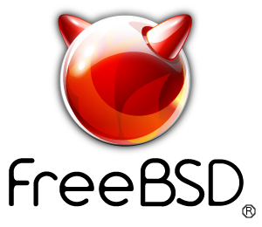


Compiler VMs
Build in VMs: Simple Reset
Build on specific distro and version
  Different versions of libraries used
Different CPU Architectures
Notes:
Run on VMs with Snapshots
Allows simple reset to known clean state between builds
Not all Linux are the same
Each distro has different packages available and may not provide latest version of a package
may plan on building native packages which usually requires the platform to build
Different CPU architectures?

Slide 5
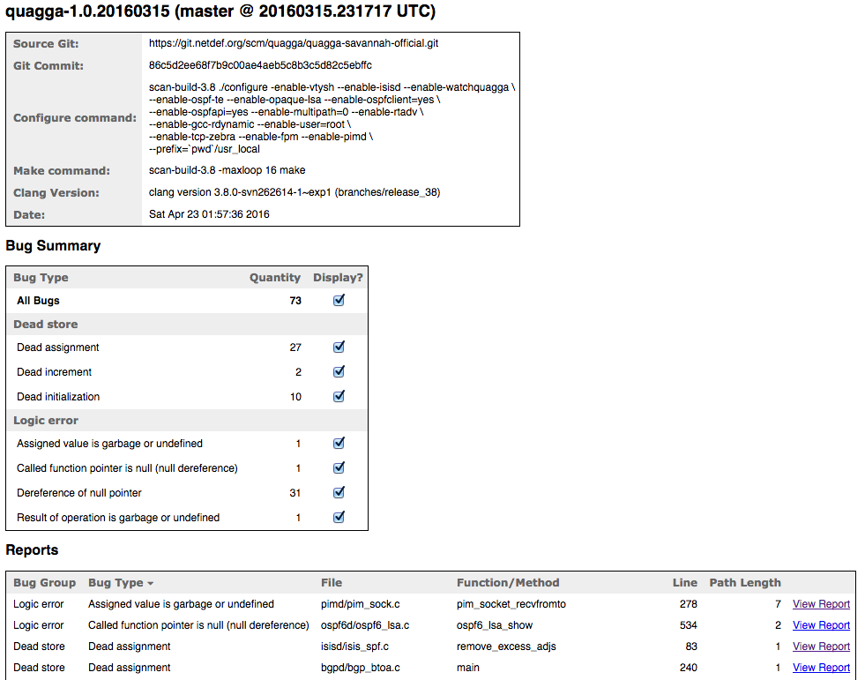
Static Analysis: Clang-Analyzer
Notes:
Pro:
Free, can run on your own hardware
No limits on number of runs
Results can be attached to specific code (ie development commit)
Easy to publish (nice test reports)
Cons:
How to produce a unique bugid for each issue across multiple runs?
Only get bug type / file / function name / linenumber

Slide 6
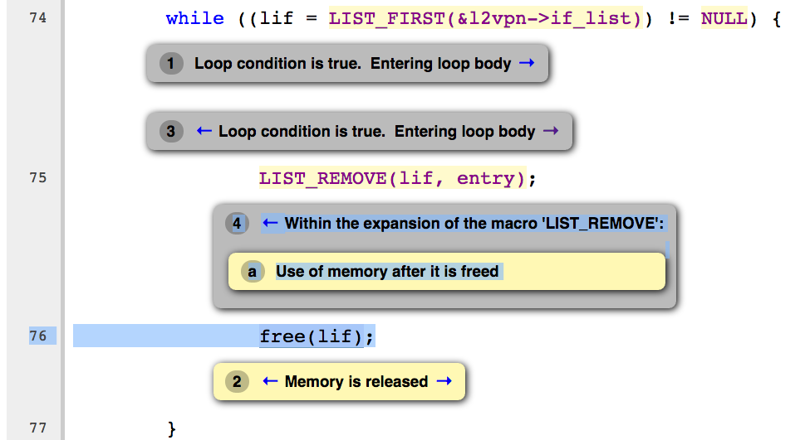
Static Analysis: Clang-Analyzer
BUT: Expect a lot of bad warnings…
Notes:
Expect a lot of wrong warnings

Slide 7
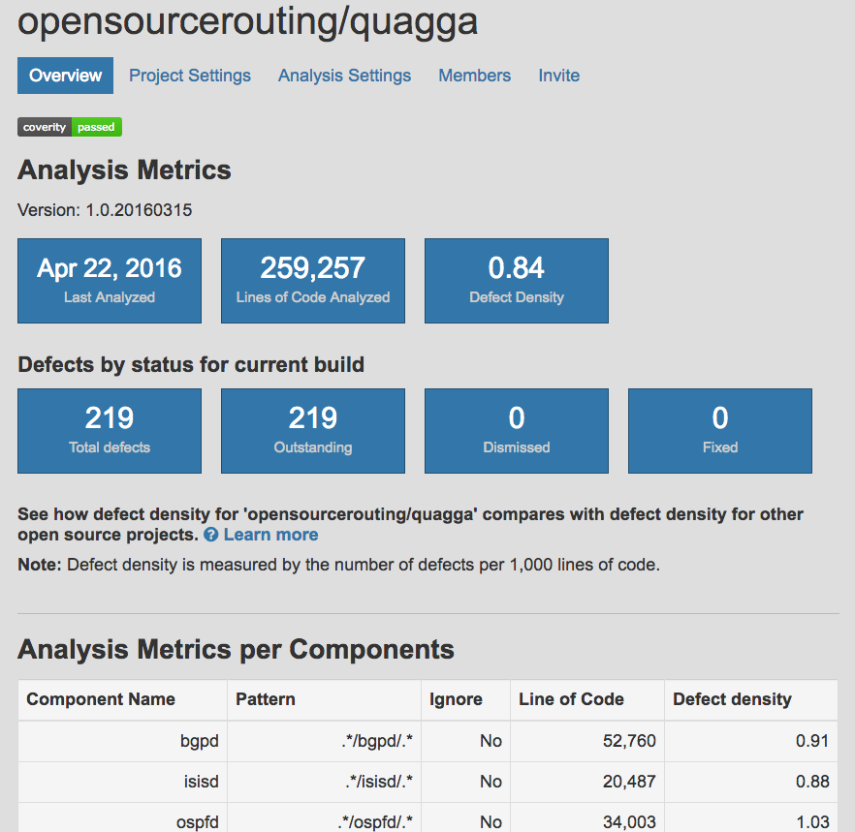
Static Analysis: Coverity Scan
Notes:
Pro:
Less false warnings than Clang
Finds different issues
Creates a CID (Coverity ID) number for each bug found
Results can be attached to specific code (ie development commit)
Easy to publish (nice test reports)
Allows classification on their own web interface
Cons:
Free only for Open Source Projects
Limited number of runs
Running in multiple branches (ie experimental, development and stable) mixes the public bug statistics
Logins required – even for viewing bugs
How to extract/archive report?

Slide 8
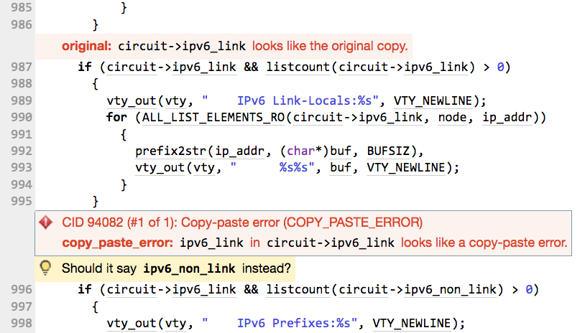
Static Analysis: Coverity Scan
Nice: Finds some Copy & Paste errors!
Notes:
Finds some copy&paste errors!

Slide 9
Code Coverage
?
[this slide is left blank – we don’t do this yet]

Slide 10
Testing Tools
Tools used for Testing

Slide 11
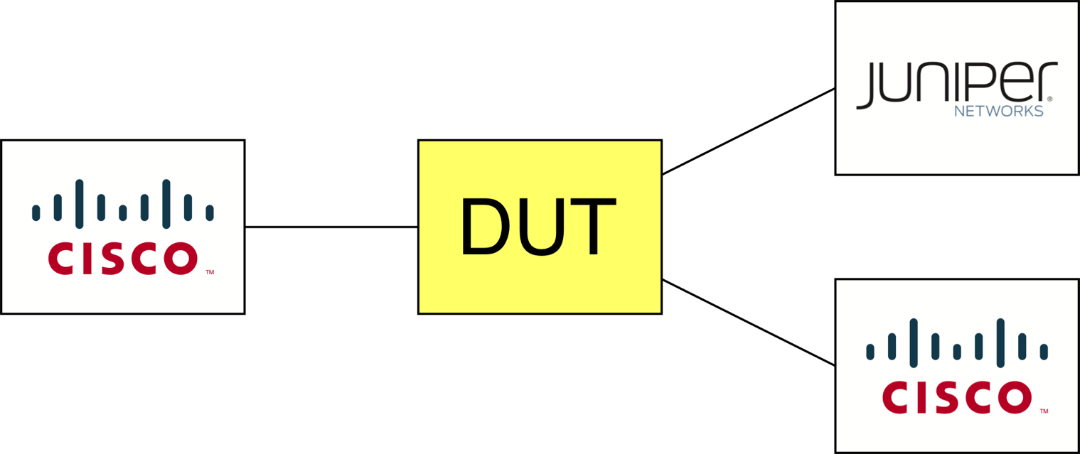
RFC Compliance Tests
Interoperability with Cisco/Juniper ≠ RFC Compliance Test
Hint:
BGP Transitive Attributes
Error Handling
Notes:
BGP Transitive Attributes – unknown attributes might be forwarded from the dark far corners of the Internet
Error handling: Cisco/Juniper might not allow to create negative tests.
(BGP example) Some errors require the DUT to correct the update or ignore or close session

Slide 12
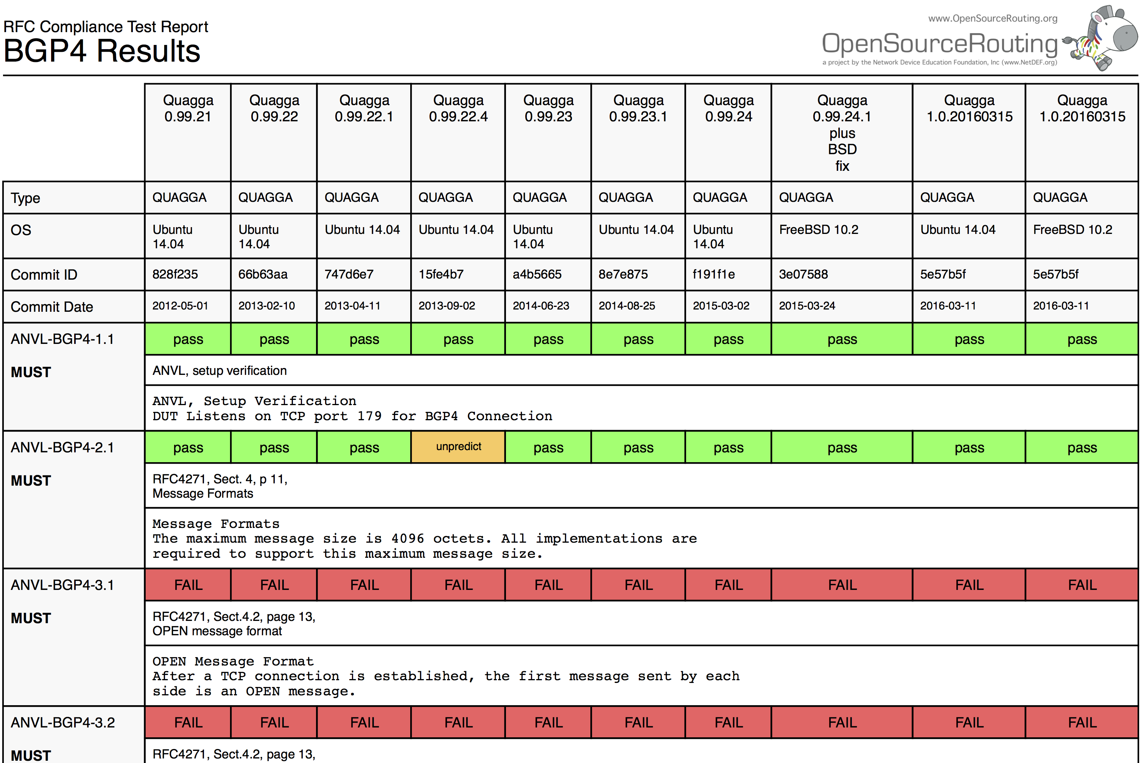
RFC Compliance Test: Ixia ANVL
Notes:
Unfortunately no Open Source Alternative
Market too small?
Pro:
Not just testing RFC – very thorough test of CLI as well
We execute approx 2300 Test cases across different protocols
Each test requires different config or topology
Great test coverage on functionality
Includes negative tests as well
Cons:
Expensive to buy and expensive to keep up to date
Slow
Difficult to set up – not click and run
Can’t share full failure logs
Test method is the Ixia knowhow
All we can share on pass/failed tests is seen in this spreadsheet: Testnumber, result, RFC and summary

Slide 13
Protocol Fuzzer
BGP OPEN Message Format (RFC 4271)
0 1 2 3
0 1 2 3 4 5 6 7 8 9 0 1 2 3 4 5 6 7 8 9 0 1 2 3 4 5 6 7 8 9 0 1
+-+-+-+-+-+-+-+-+
| Version |
+-+-+-+-+-+-+-+-+-+-+-+-+-+-+-+-+
| My Autonomous System |
+-+-+-+-+-+-+-+-+-+-+-+-+-+-+-+-+
| Hold Time |
+-+-+-+-+-+-+-+-+-+-+-+-+-+-+-+-+-+-+-+-+-+-+-+-+-+-+-+-+-+-+-+-+
| BGP Identifier |
+-+-+-+-+-+-+-+-+-+-+-+-+-+-+-+-+-+-+-+-+-+-+-+-+-+-+-+-+-+-+-+-+
| Opt Parm Len |
+-+-+-+-+-+-+-+-+-+-+-+-+-+-+-+-+-+-+-+-+-+-+-+-+-+-+-+-+-+-+-+-+
| |
| Optional Parameters (variable) |
| |
+-+-+-+-+-+-+-+-+-+-+-+-+-+-+-+-+-+-+-+-+-+-+-+-+-+-+-+-+-+-+-+-+
Notes:
Basic Function of a Fuzzer:
attacks the System with malformed packets.
Good Fuzzer knows packet and doesn’t just random changes.
Fields missing, too long, too short
Value in field just 1 too high or too low
Negative values (or what might be negative if someone accidently uses a signed integer)
Verifies recovery of system between each test (or multiple tests)
May measure CPU load and response time as well and alert on unusual high values

Slide 14
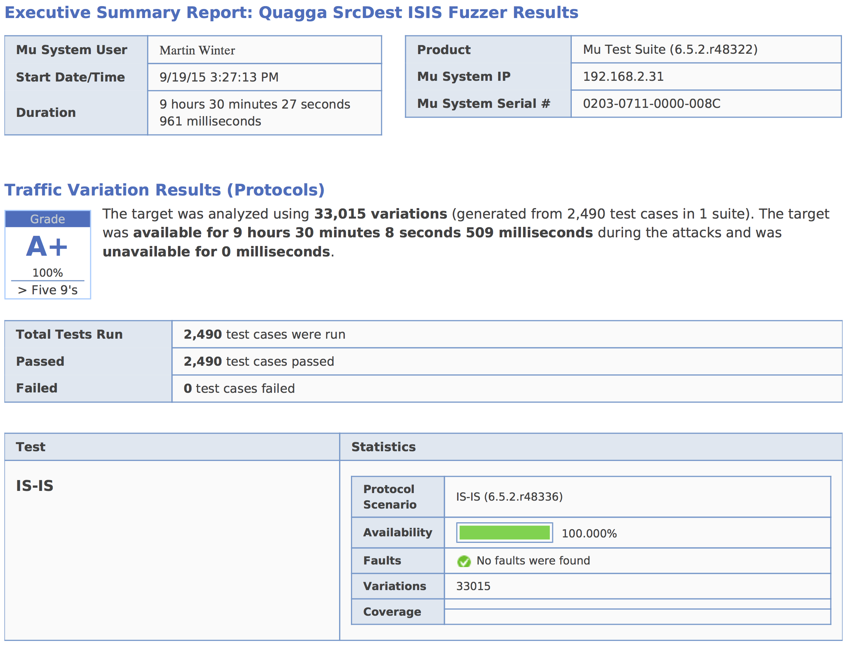
Protocol Fuzzer: Spirent SPS-8000
Notes:
Pro:
Spirent is great supporter of Open Source projects. Talk to them about your needs. It may be free…
Simple to setup and run
Produces Proof-of-concept distributable binary for single failed testcase
Cons:
This particular Software is a bit outdated (Newer replacement software not yet ready)
Does not modify the configuration on the DUT – may need multiple runs with different config
Very slow – can take weeks for a full testrun.
Open Source Alternative
Some available, but no predefined routing protocol templates (ie Peach Fuzzer)

Slide 15
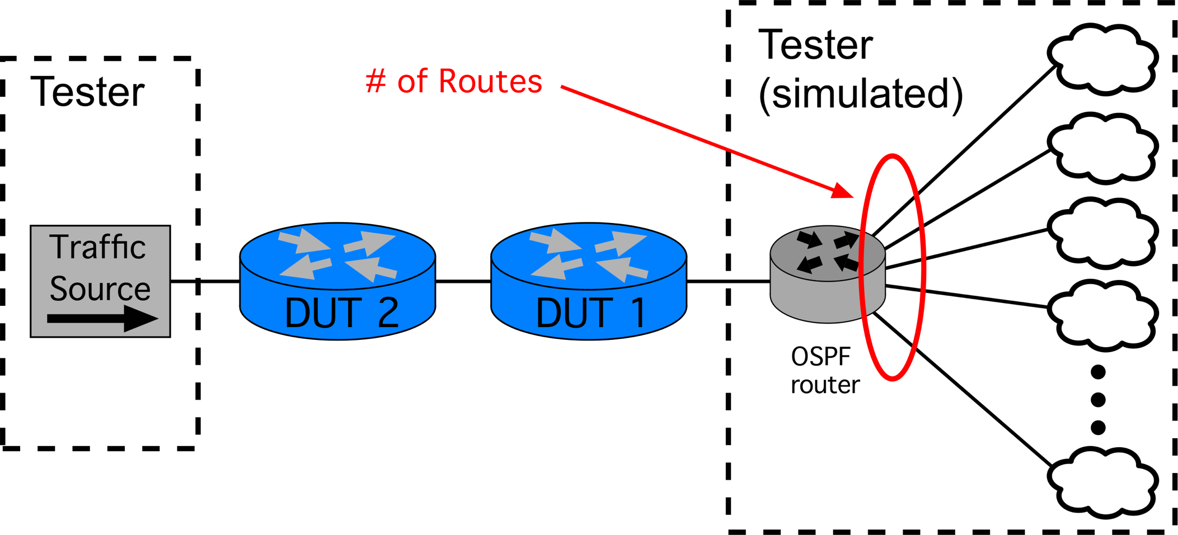
Protocol Performance & Scale
Example – Scale using external routes in OSPF
Test traffic sent to an IP on each external route

Slide 16
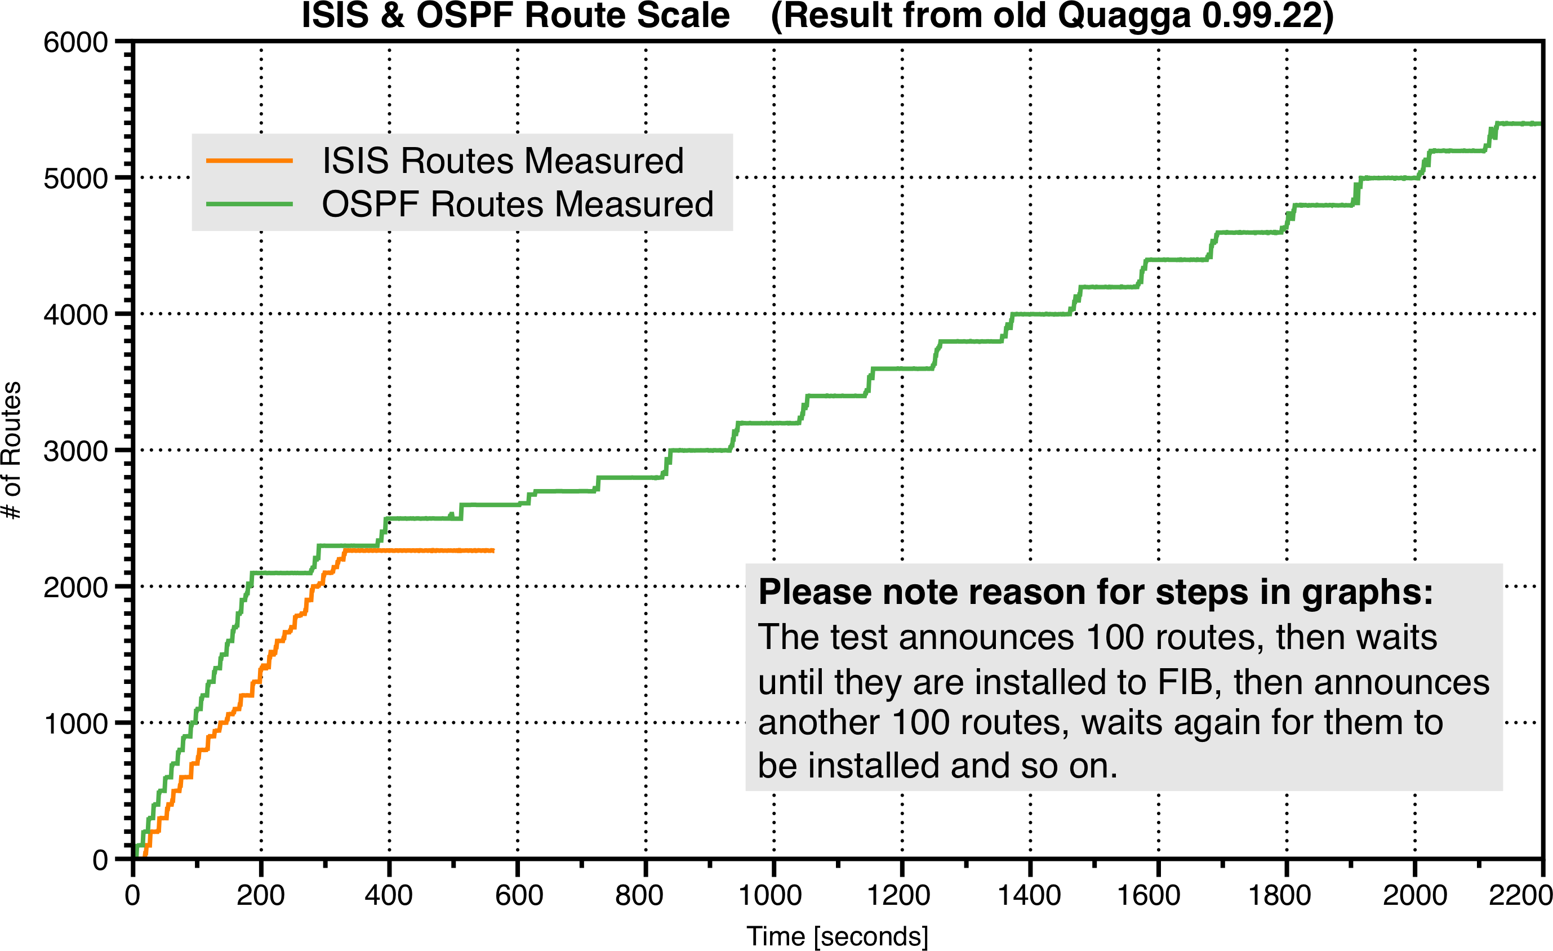
Protocol Performance & Scale

Slide 17
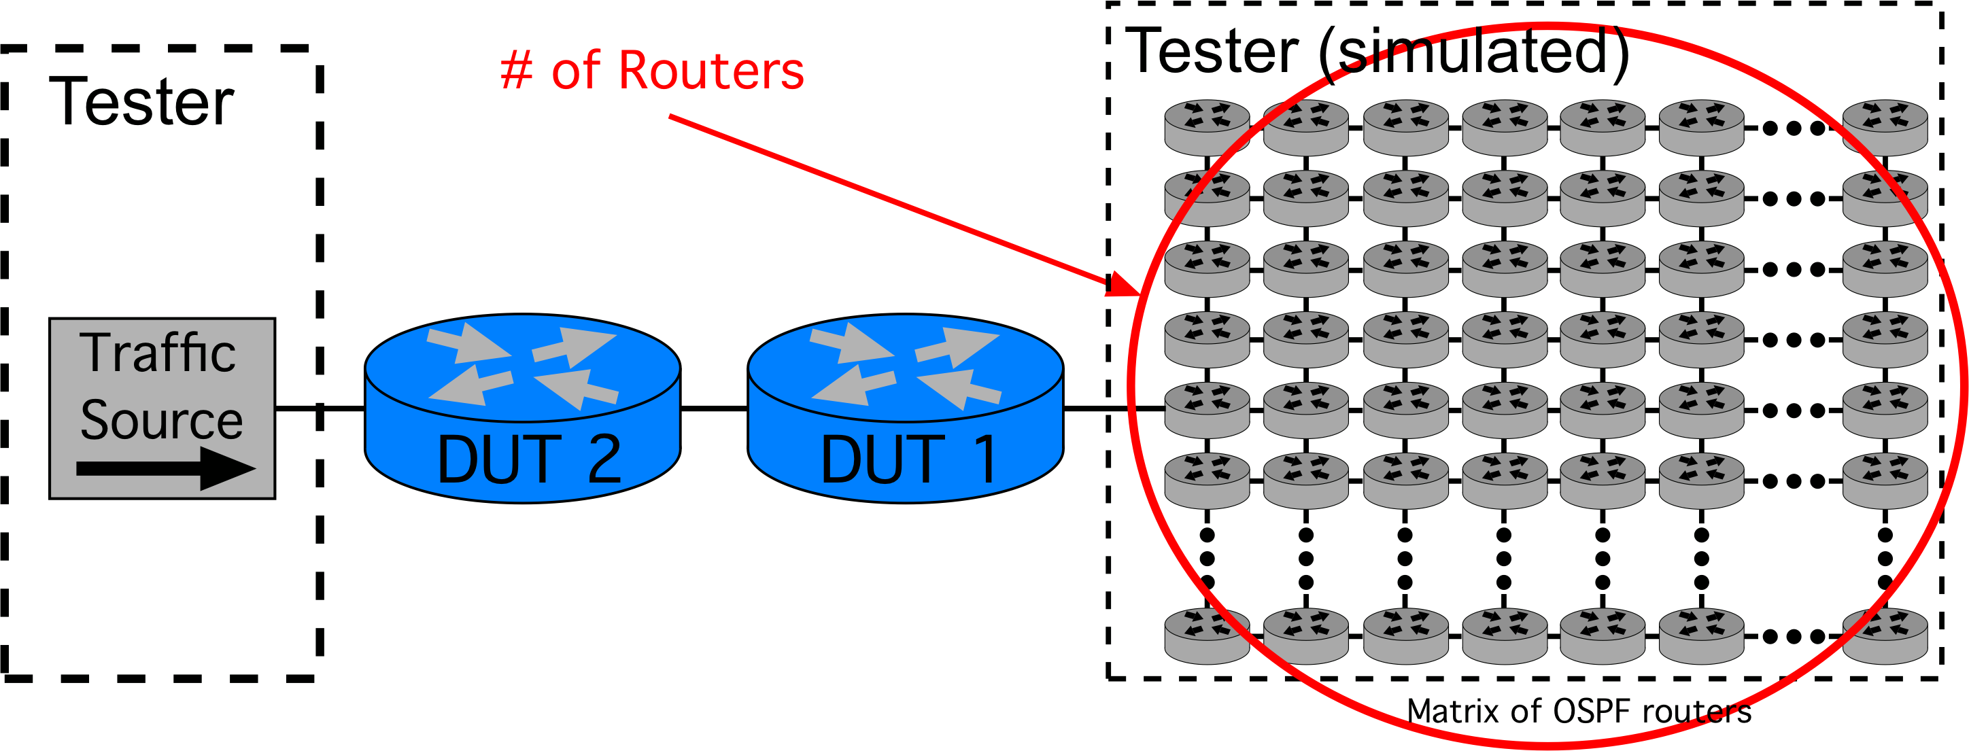
Protocol Performance & Scale
Example – Scale using internal routes in OSPF
Test traffic sent to an IP on each link in matrix

Slide 18
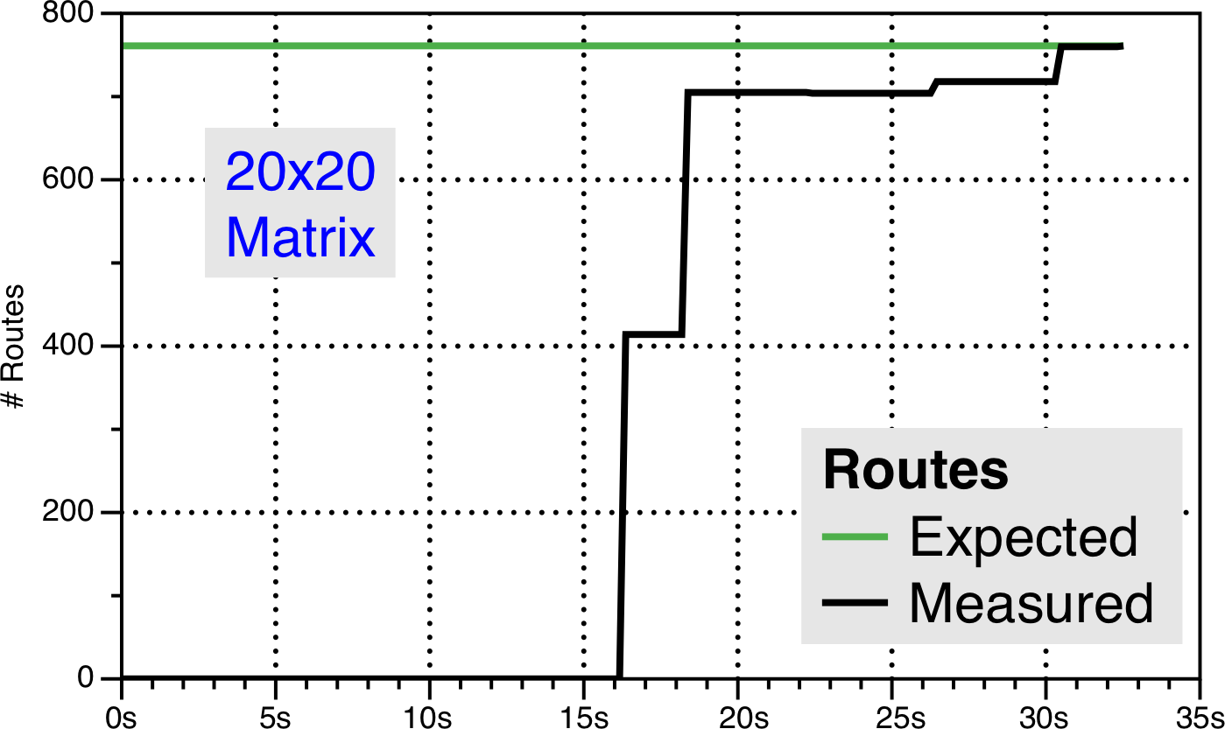
Protocol Performance & Scale
(Result from old Quagga 0.99.22)
Notes:
All normal result at 20x20 matrix.

Slide 19
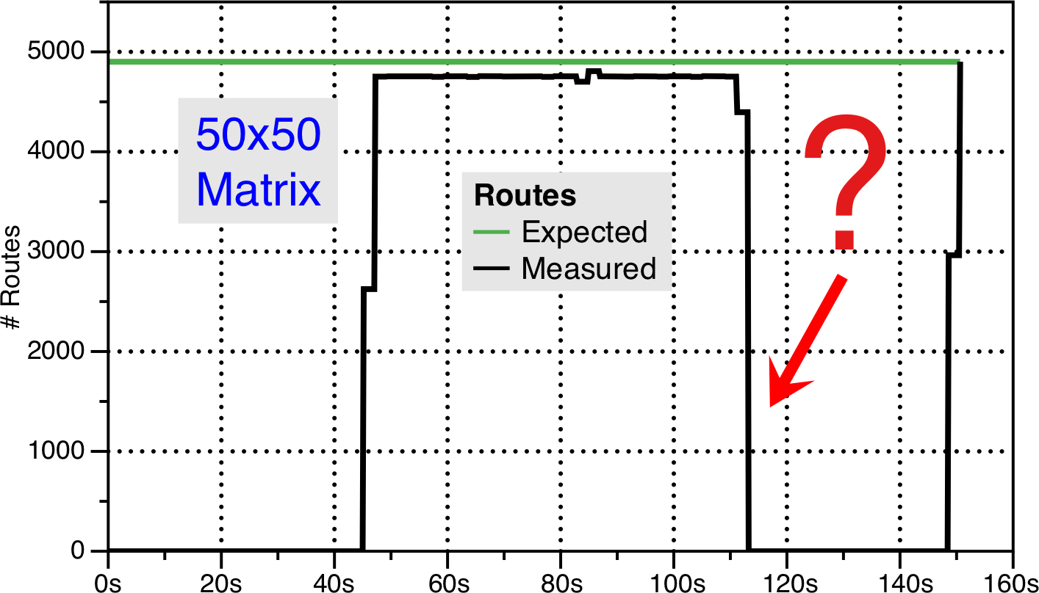
Protocol Performance & Scale
(Result from old Quagga 0.99.22)
Notes:
Oops – bad behavior at 50x50 matrix

Slide 20
Protocol Performance & Scale
How to summarize result? (Pass/Fail)
Testing in VM or physical machine?
Tools for testing?
  ExaBGP for BGP
  no tools for OSPF/ISIS/RIP/PIM/….

Slide 21
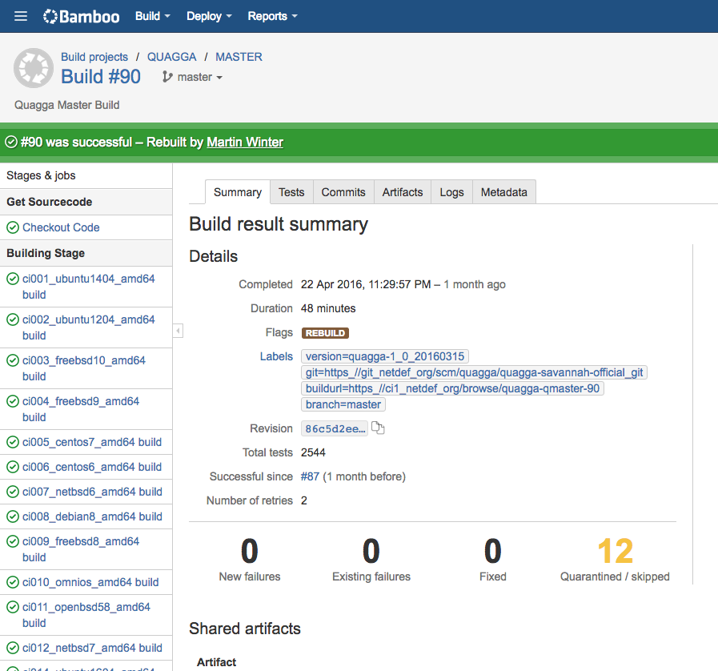
Automate (incl Result Parsing!)
Notes:
Automate with CI system and automate the result parsing as well. Assume that the person submitting the code does it the first time and doesn’t know anything

Slide 22
Links
  NetDEF CI System
    https://ci.netdef.org
  Quagga RFC Compliance Reports
    https://www.opensourcerouting.org/compliance-test-results/
  More details on our testing:
    https://www.opensourcerouting.org/2016/05/whitepaper-how-opensourcerouting-tests-quagga

Slide 23
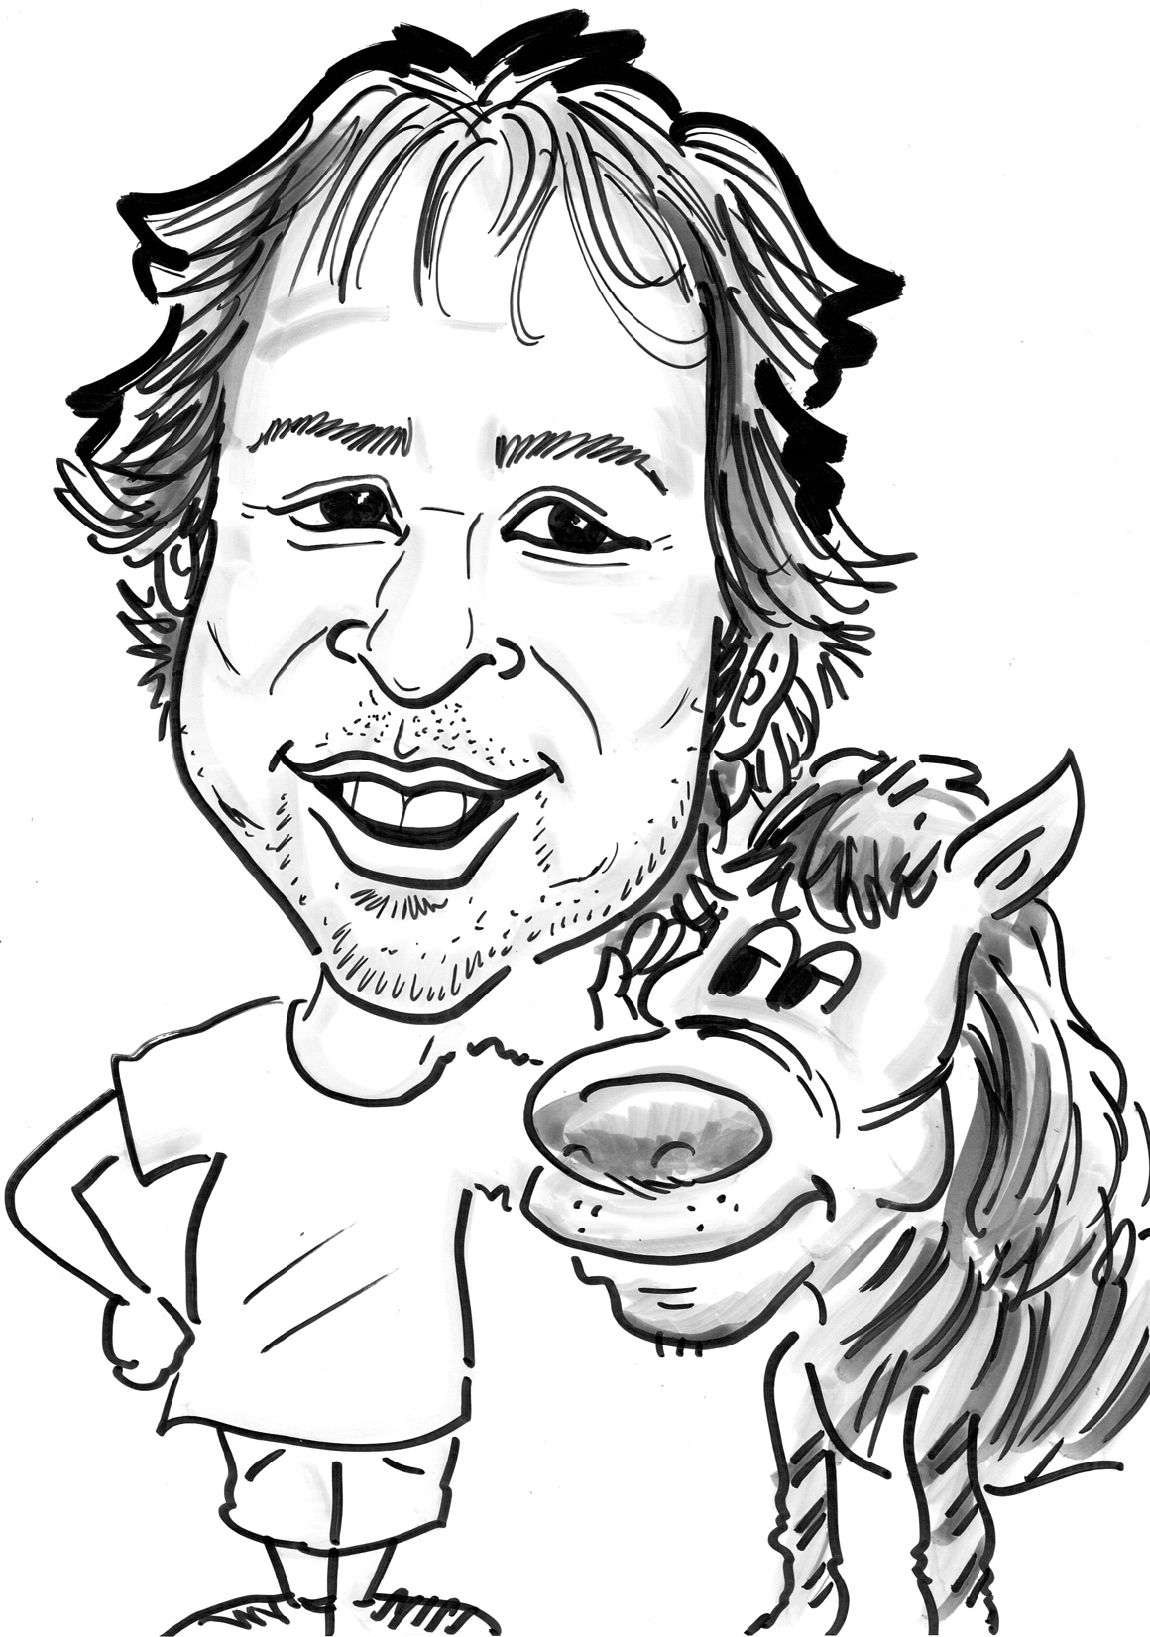

Questions ?
Martin Winter
mwinter@netdef.org
Network Device Education Foundation (NetDEF)
www.netdef.org / www.opensourcerouting.org

