Slide 1
Interconnection in the Nordics
RIPE72 - Copenhagen
Lasse Jarlskov

Slide 2
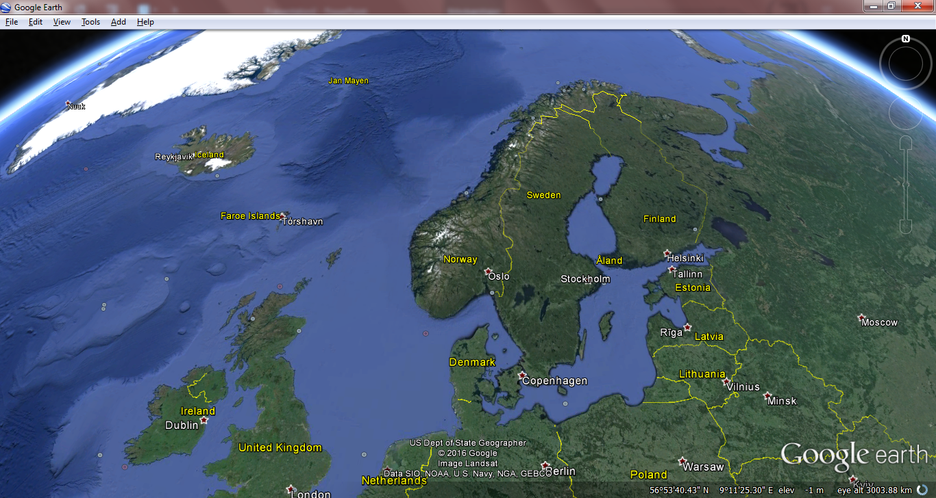
The Nordics
Scandinavia explained:
https://youtu.be/TsXMe8H6iyc
Interconnection in the Nordics, RIPE Copenhagen 2016

Slide 3
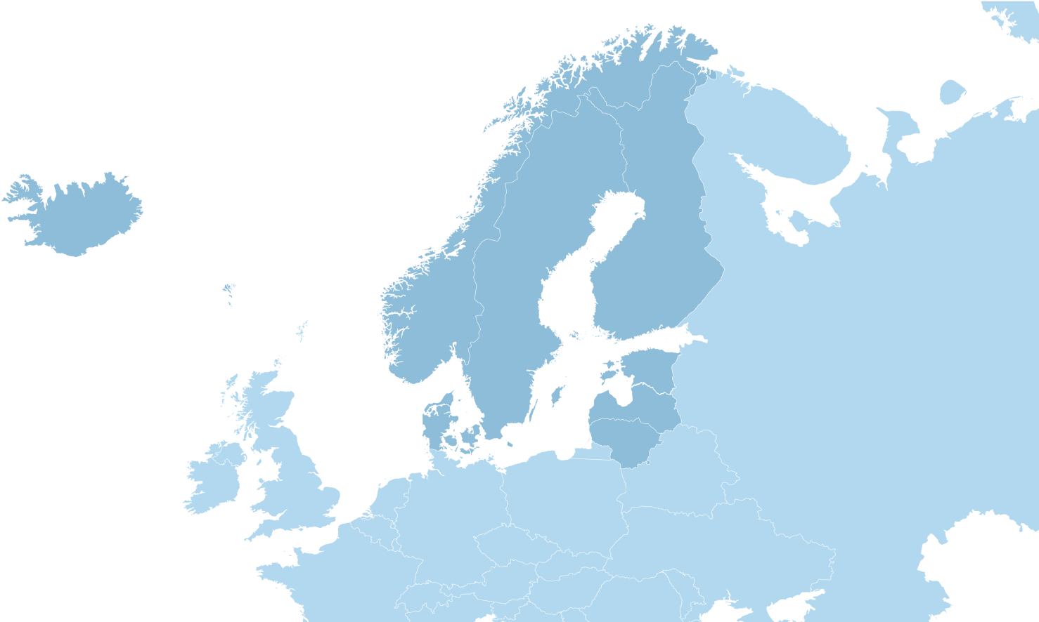
The Countries
Agenda
The Connectivity
How to connect.
The Markets
Who to connect with.
The Datacentres and IXPs
Where to connect.
Denmark
Sweden
Norway
Finland
Iceland
Self-governing regions:
Greenland (Denmark)
Faroe Islands (Denmark)
Åland (Finland)
Interconnection in the Nordics, RIPE Copenhagen 2016

Slide 4
Country Overview
And top broadband-operators / incumbents
Denmark | Sweden | Norway | Finland | Iceland | Greenland | Faroe Islands | Åland
Copenhagen | Stockholm | Oslo | Helsinki | Reykjavik | Nuuk | Torshavn | Mariehamn
5,7M | 9,9M | 5,2M | 5,5M | 300K | 56K | 50K | 26K
.dk | .se | .no | .fi | .is | .gl | .fo | .ax
Lego | IKEA | Fjords | Lakes | Geysers | Polar bears | Tunnels | Kurtis!
TDC | Telia | Telenor | Sonera/ Elisa | Siminn | Tele-Greenland | Faroese Telecom
Interconnection in the Nordics, RIPE Copenhagen 2016

Slide 5
Highlights
Or ”Where to PoP?”
Stockholm
Interconnection hub of the Nordics
Lots of russian carriers peering here
Copenhagen
Gateway to the Nordics
40% of swedes live closer to Copenhagen than to Stockholm
Helsinki
Gateway to the east (Russia, China and the baltics)
Reykjavik
Free power and cooling
Expensive connectivity

Slide 6
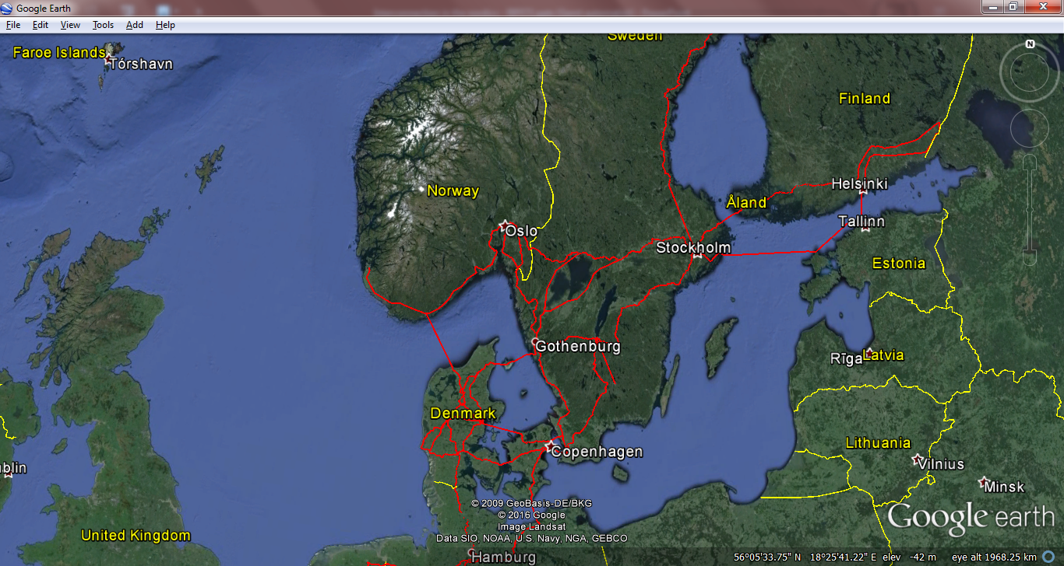
The Connectivity in Scandinavia+Finland
Main routes:
Copenhagen-Stockholm-Oslo-triangle
Copenhagen-Hamburg
Stockholm-Helsinki-Tallinn-Stockholm
Caveats:
Copenhagen choke-point. (5km)
Alternatives:
Stockholm-Gothenburg-Hamburg
Oslo-Kristiansand-Hamburg
Helsinki-Moscow
Helsinki-Talinn-Warsaw
New developments (sea-cables):
C-LION; Helsinki-Rostock
Denmark – United Kingdom
Towards Moscow
Towards Warsaw
http://cinia.eu/en/c-lion
Interconnection in the Nordics, RIPE Copenhagen 2016

Slide 7
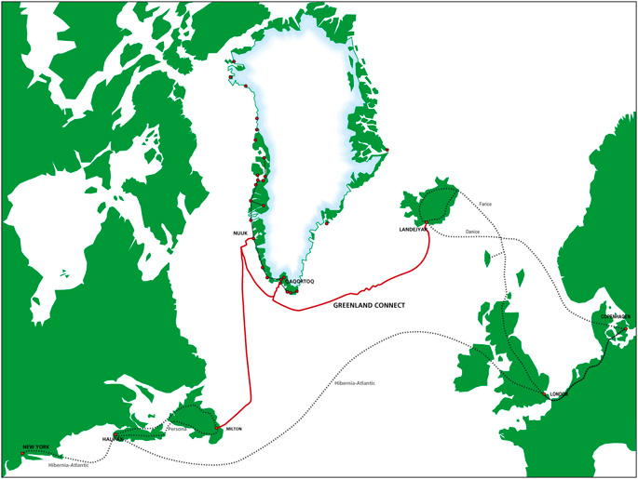
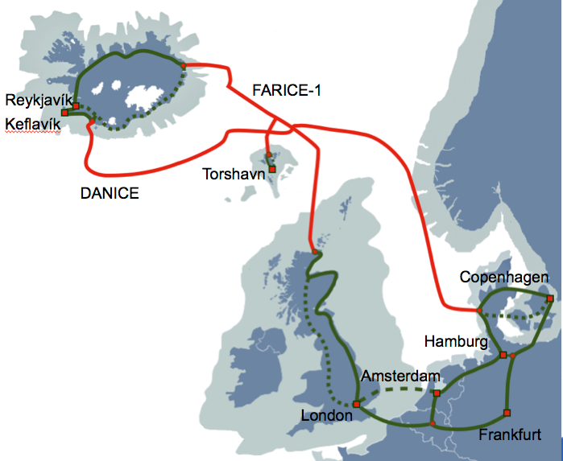
The connectivity - Atlantics
Greenland connect
FARICE
Interconnection in the Nordics, RIPE Copenhagen 2016

Slide 8
The Markets
Residential broadband subscriptions (incl. mobile broadband)
Denmark | Sweden | Norway | Finland
Copenhagen | Stockholm | Oslo | Helsinki
5,7M | 9,9M | 5,2M | 5,5M
.dk | .se | .no | .fi
Lego | IKEA | Fjords | Lakes
TDC (AS3292) | Telia (AS3301) (part of AS1299) | Telenor (AS2119) | Elisa (AS6667)
Stofa (AS39642) | Telenor (AS2119) | GET (TDC) (AS41164) (part of AS3292) | Sonera (AS1758) (part of AS1299)
Telenor (AS9158) (part of AS2119) | Tele2 (AS1257) | NextGenTel (AS15659) | DNA (AS16086)
Telia (AS3308) (part of AS1299) | 3 (AS44034) | Altibox (AS29695) | Finnet (AS47605)
 | ComHem (AS39651)
Interconnection in the Nordics, RIPE Copenhagen 2016
Notes:
DK: TDC (57%), Stofa (12%), Telenor (7%), Telia (3,8%), Rest: 20% on smaller players
SE: TeliaSonera (35%), Telenor (21%), Tele2 (18%), 3 (12%), ComHem (5%), Rest 9% on smaller players
NO: Telenor (42,3%), GET (16,9%), NextGenTel (7,5%), Altibox (?)
FI: TeliaSonera (31%), Elisa (32%), DNA (24%), Finnet (11%), AS47605

Slide 9
The Markets
Notable aggregators - local wholesale IP transit-providers
Denmark | Sweden | Norway | Finland
Copenhagen | Stockholm | Oslo | Helsinki
5,7M | 9,9M | 5,2M | 5,5M
.dk | .se | .no | .fi
Lego | IKEA | Fjords | Lakes
TDC (AS3292) | Telia (AS3301) (part of AS1299) | Telenor (AS2119) | Elisa (AS6667)
Nianet (AS31027) | IP-only (AS12552) | TDC (AS3292) | Sonera (AS1758) (part of AS1299)
GlobalConnect (AS9158) | Bahnhof (AS8473) | Broadnet (AS15659) | DNA (AS16086)
Telia (AS3308) (part of AS1299) | TDC (AS3292) |  | Finnet (AS47605)
 | Bredband2 (AS29518)
Interconnection in the Nordics, RIPE Copenhagen 2016

Slide 10
IXPs and datacentres
Copenhagen
IXPs:
Datacentres:
COMIX (COpenhagen/Malmö Internet eXchange)
Operated by Netnod
InterXion CPH, GlobalConnect, Telia Telehouse, Malmö/B, Malmö Vestergatan
~40 networks, ~55G, increasing
Fun fact: 40% of swedes live closer to Copenhagen than to Stockholm
DIX (Danish Internet eXchange point)
Operated by the Technical University
Locations: Lyngby, InterXion CPH, Skanderborg
44 networks, ~70G, declining/stable
InterXion CPH
Known operational level and quality
Not on the direct fiber-path for international connectivity
GlobalConnect – Hørskætten
Aggregation-point for (almost) all small local networks.
On direct international fiber-paths.
No remote-hands-service.
Telia Telehouse – Sydvestvej
The legacy telco-site
Where most international fiber lands.
Almost(?) completely full
Interconnection in the Nordics, RIPE Copenhagen 2016

Slide 11
Local Datacentres and IXPs
Stockholm
IXPs:
Datacentres:
Netnod Stockholm
Two LANs – mandatory to connect to both
”Why sell one port, when you can sell two at double the price”
About 1100 Gbps across both LANs
Participants from Russia, Finland and the Baltics
STHIX
Independent IXP in Stockholm
Netnod COMIX
Copenhagen/Malmö metro-region
Participants from Denmark and Sweden
Fun fact: ”40% of Swedes live closer to Copenhagen, than to Stockholm”
Netnod Gothenburg, Sundsvall, Luleå
Local participants
InterXion Stockholm, Kista
TeleCity Stockholm 1, Bromma
Both sites are equally popular
~10 km apart
Local Netnod presence (WDM) in both
TeleCity Stockholm 2, Sköndal
Far south of Stockholm – no cross-campus cross-connects, 20+ km
Digiplex, Upplands Väsby
Up and coming.

Slide 12
Local Datacentres and IXPs
Oslo
IXPs:
Datacentres:
The University of Oslo runs six IXPs:
NIX1, Oslo
60 Gbps
NIX2, Oslo
10 Gbps
Also in Bergen, Trondheim, Stavanger and Tromsø – mainly relevant for local carriers trying to reduce latencies in a vast country
Bulk is threatening to start a new IXP in HMG9
Digiplex, Ulvenveien (aka. ”Ulven”, The Wolf)
Well connected with lots of local providers.
Bulk Infrastructure, Hans Møller Gassmansvei 9 (aka. HMG9)
Well connected with lots of local providers.
New owner with fantastic/fanatic visions causing uncertainties about future pricing.
Some local providers looking to vacate.
Vault, Økernveien
Interconnection in the Nordics, RIPE Copenhagen 2016

Slide 13
Local Datacentres and IXPs
Helsinki
IXPs:
Datacentres:
FICIX2, Helsinki
26Gbps
FICIX1, Espoo (suburbs of Helsinki)
10Gbps
Regional exchanges:
FICIX3, Oulu
TREX, Tampere
Telecity, Helsinki,
Digita, Pasila
Nebula, Kiviaidankatu
Technopolis Innopoli (FICIX1)
legacy
Interconnection in the Nordics, RIPE Copenhagen 2016

