Slide 1
Euro-IX Update
RIPE 72 Connect WG, 2016-05-25, Copenhagen, Denmark
Arnold Nipper
arnold.nipper@de-cix.net
Twitter: @euroix

Slide 2
Euro-IX Members
An IXP Association (IXPA)
80 Affiliated IXPs
55 IXPs in the Euro-IX Region 49 Countries, operating over 100 Peering LANs
25 IXPs from the rest of the world
Newest Members: Dataline IX (Dataline, Russia) Cas-IX (N+ONE, Morocco) Espanix (Spain)

Slide 3
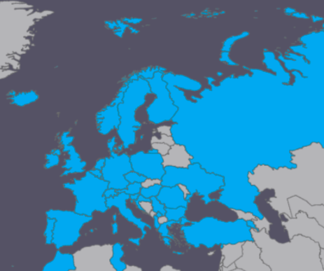
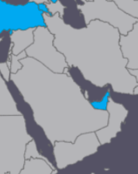
Members in Europe and ME

Slide 4
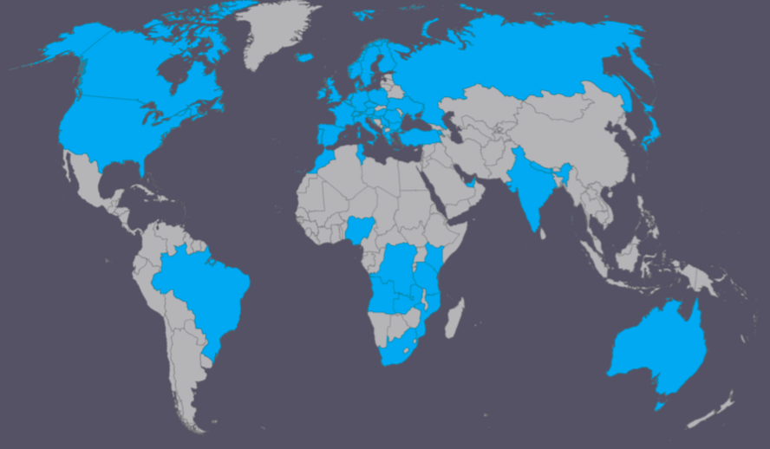
Global Membership

Slide 5
Euro-IX Patrons
15 Patrons
ADVA Optical Networking
Brocade
BTI Systems
Coriant
ECI Telecom
Equinix Telecity
Extreme Networks
FlexOptix
Huawei
Interxion
Juniper Networks
MRV
Nokia
NTT AT
Telehouse

Slide 6
What do we do?
Present two fora per year
Maintain the website, database and tools
Annual European IXP Report
Mentor-IX programme
Benchmarking Club (BMC)

Slide 7
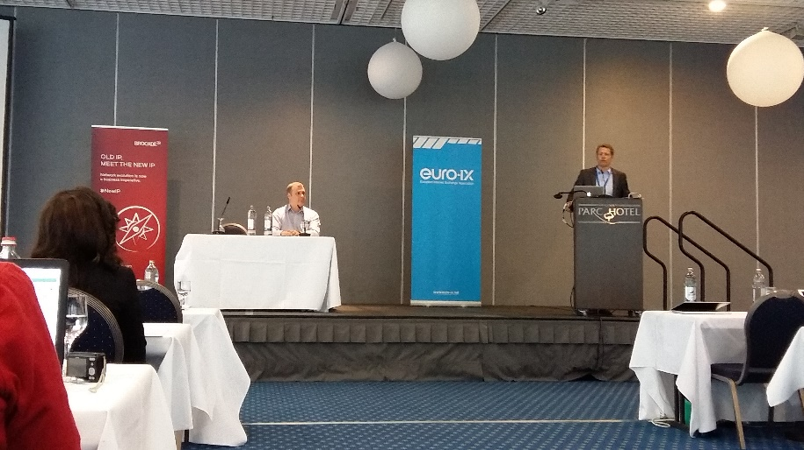
Euro-IX 28, April 2016, Luxembourg
120 Attendees, 59 Organisations, 42 IXP Operators
Hosted by LU-CIX
IXP Manager Workshop
Technical, Commercial, Regulatory and Route Server Sessions
BIRD and GoBGP Updates

Slide 8
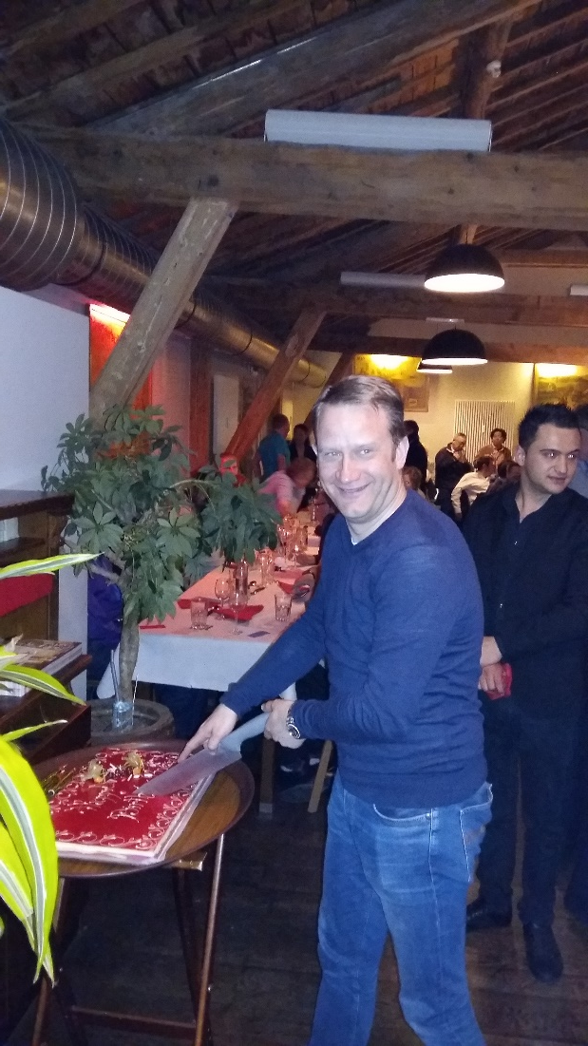
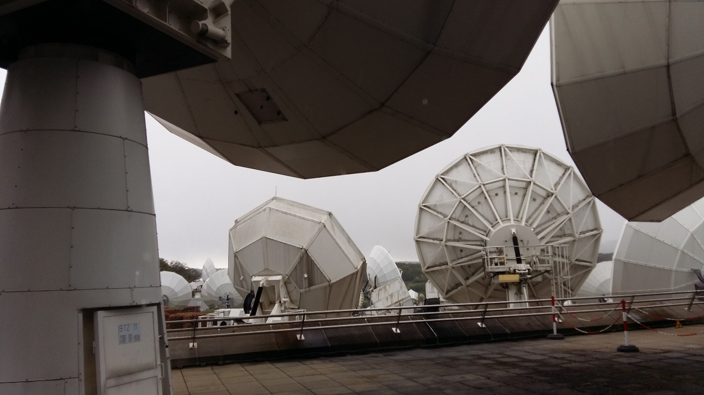
Euro-IX 28, Luxembourg
Visits to SES and RTL
Euro-IX 15th Birthday

Slide 9
Mentor-IX and Fellowship
Mentor-IX
KIXP, MOZIX, NPIX, TIX Tanzania, ZIXP
Fellowship – Funding to support IXPs
Join Euro-IX (Membership fees)
Attend Euro-IX Fora (Travel costs)
Four fellowships awarded in the last year
BIX (Beirut), GIX (Ghana), UIXP (Uganda), KINIX (DRC)
Further information about the fellowship can be found at https://www.euro-ix.net/ixps/support-ixps/fellowship-program/
Thanks to INEX, ISOC, FICIX, InterLAN and DE-CIX

Slide 10
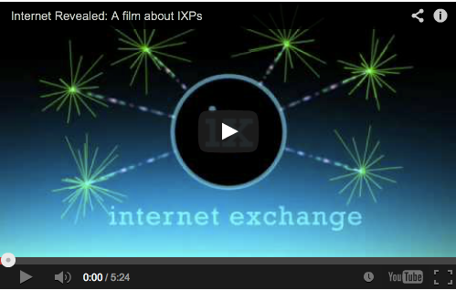
The Internet Revealed – IXP Movie
In English, German, French, Italian, Turkish, Spanish, Romanian, Portuguese, Arabic and Chinese on our YouTube channel: youtube.com/channel/UCFyucVRAAMzxyJIsxnGwsjw

Slide 11
Stay in touch
Monthly newsletter – subscribe here:
euro-ix.net/news-and-events/newsletter/
Social Media
Twitter @euroix
Facebook fb.me/maineuroix

Slide 12
Thank you!
secretariat at euro-ix dot net

