Slide 1
Blackholing at IXPs
On the Effectiveness of DDoS Mitigation in the Wild
RIPE 72
Christoph Dietzel ¹ ², Anja Feldmann ¹, Thomas King ²
¹ INET, TU Berlin
² R&D, DE-CIX

Slide 2
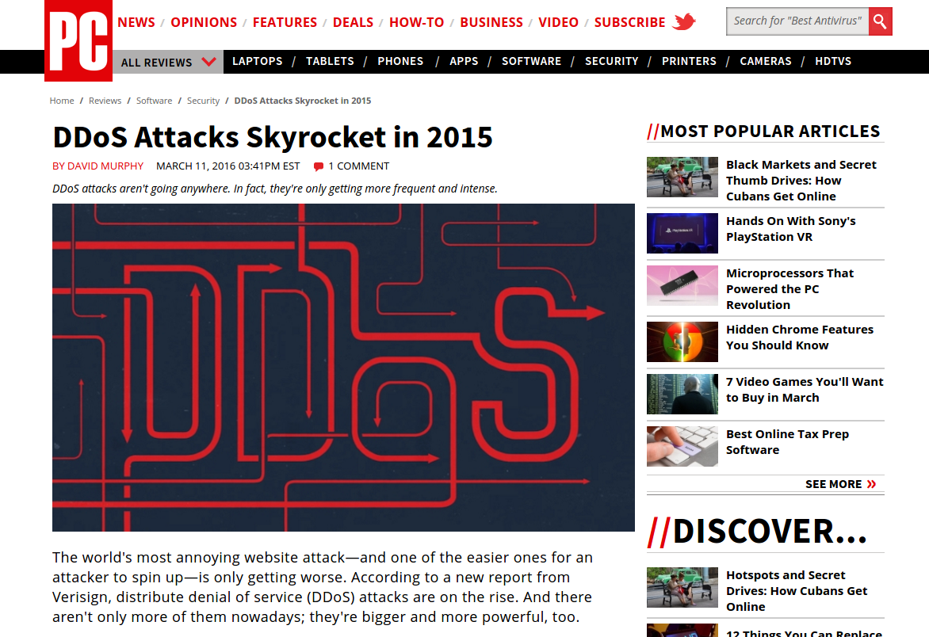
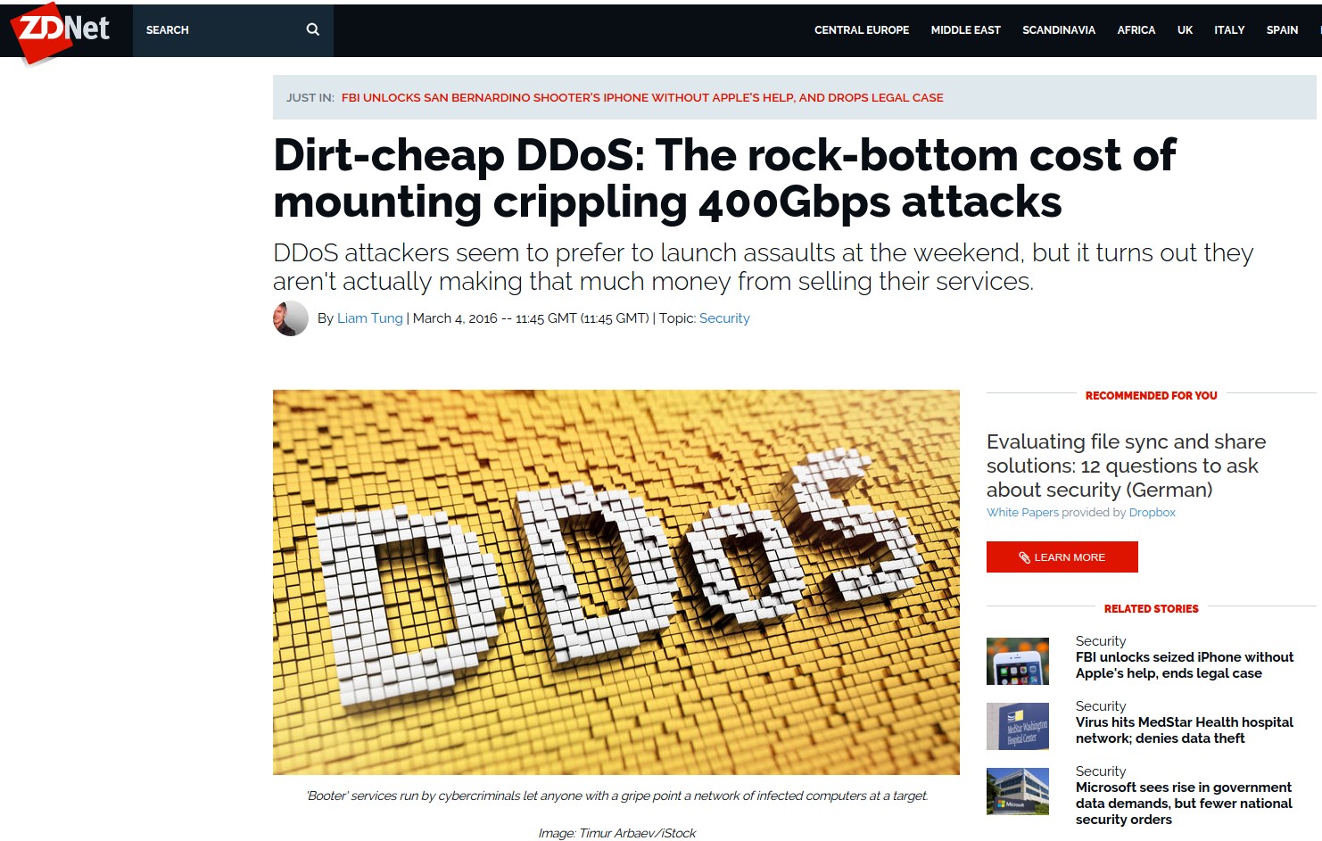
DDoS Attacks Remain a Serious Threat

Slide 3
What is Blackholing?
Operational technique to counter DDoS attacks
Triggered directly by IP owners through BGP
Last resort to protect upstream/peering link or own network
Since a few years also at IXPs (DE-CIX, MSK-IX, NETIX, NIX-CZ, …)

Slide 4
Recap – Blackholing at IXPs
next hop:
IP D
next hop:
IP D
next hop:
IP D
IXP
next hop:
IP BH
network
datacenter
AS D

Slide 5
Recap – Blackholing at IXPs
next hop:
IP D
next hop:
IP BH
next hop:
IP BH
IXP
next hop:
IP BH
network
datacenter
AS D

Slide 6
Is it frequently used and how is it used?
What is the impact on traffic?
How can we improve blackholing?

Slide 7
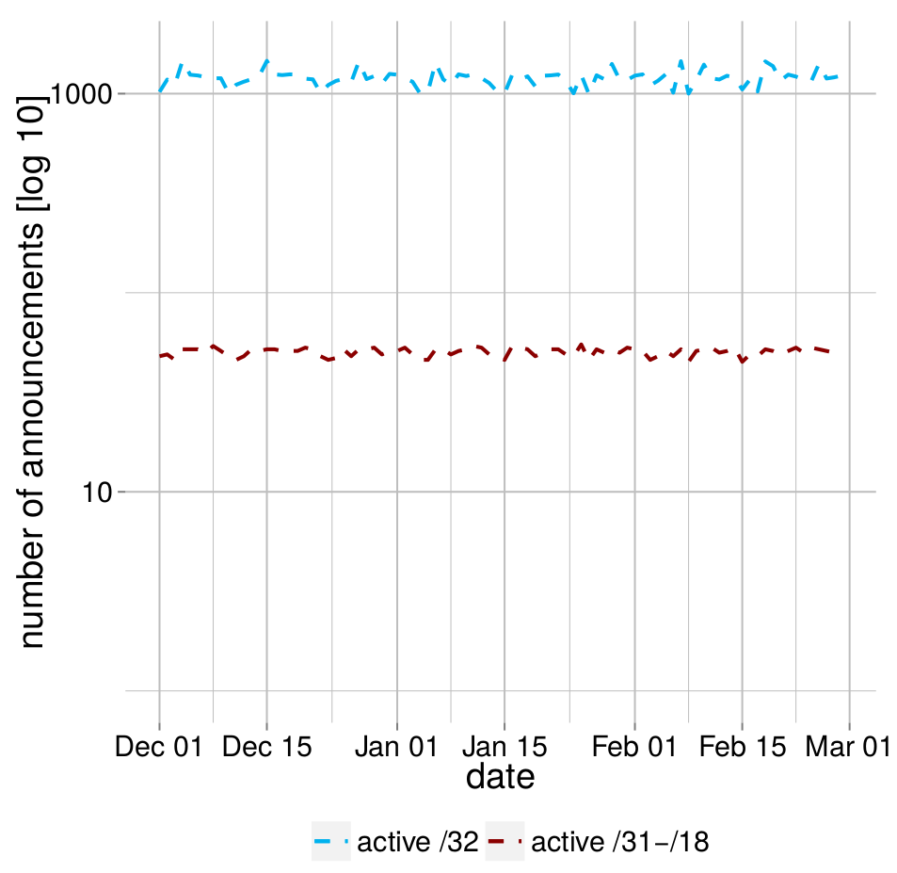
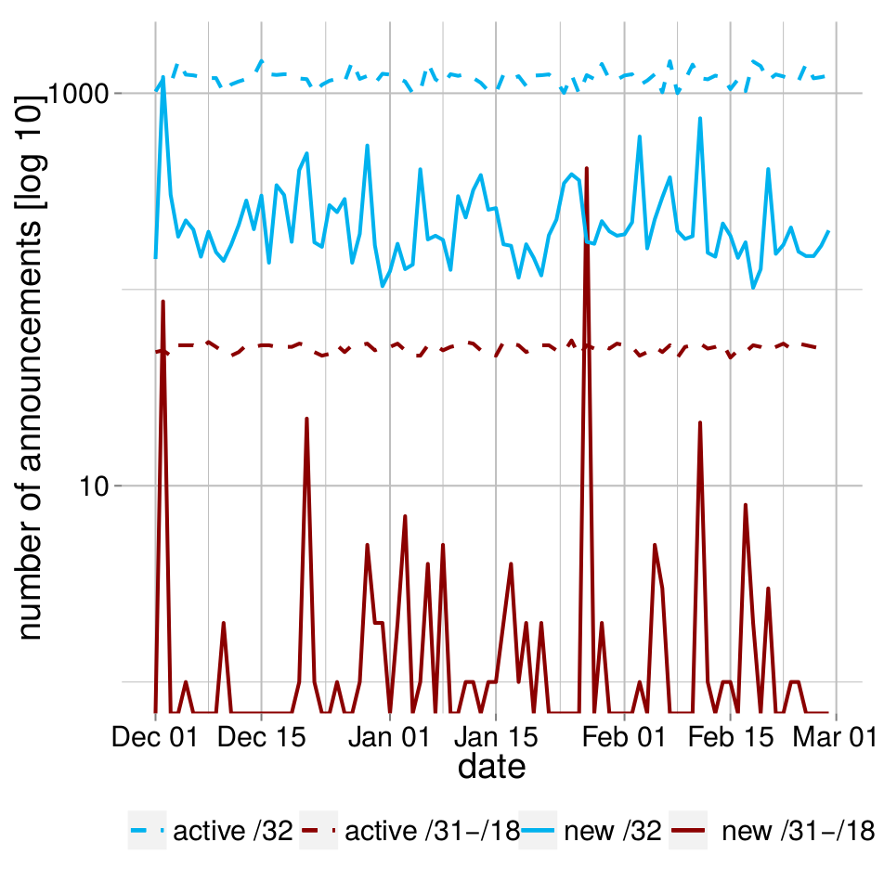
Blackholing Usage Analysis – Active Announcements
About 23,000 announcements
Stable number of active /32 blackholes (~1200)
Also stable number of less specifics /31 - /18 (~50)
What about new announcements?

Slide 8
Blackholing Usage Analysis – New Announcements
High variance in new announcements
Spikey less specifics
(/31 - /18)
Blackholing is indeed widely used!
But which prefix sizes?

Slide 9
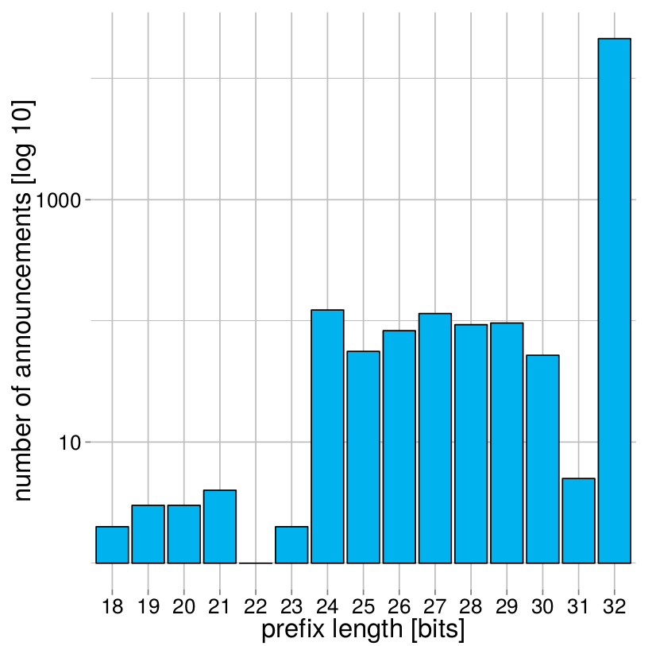
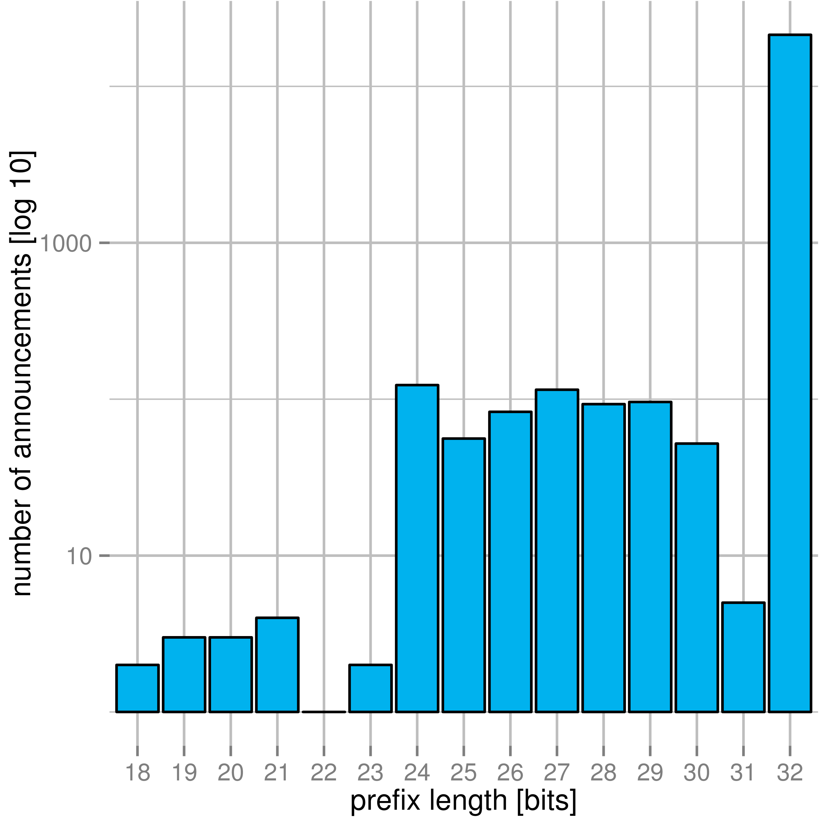
Blackholing Usage Analysis – Prefix Length
Mainly /32 announcements (97%)
/24 - /31 account
for 2.5%
9 announcements
for < /24
More specific acceptance needed
Announced for how long?
Notes:
22,994 blackholing BGP announcements

Slide 10
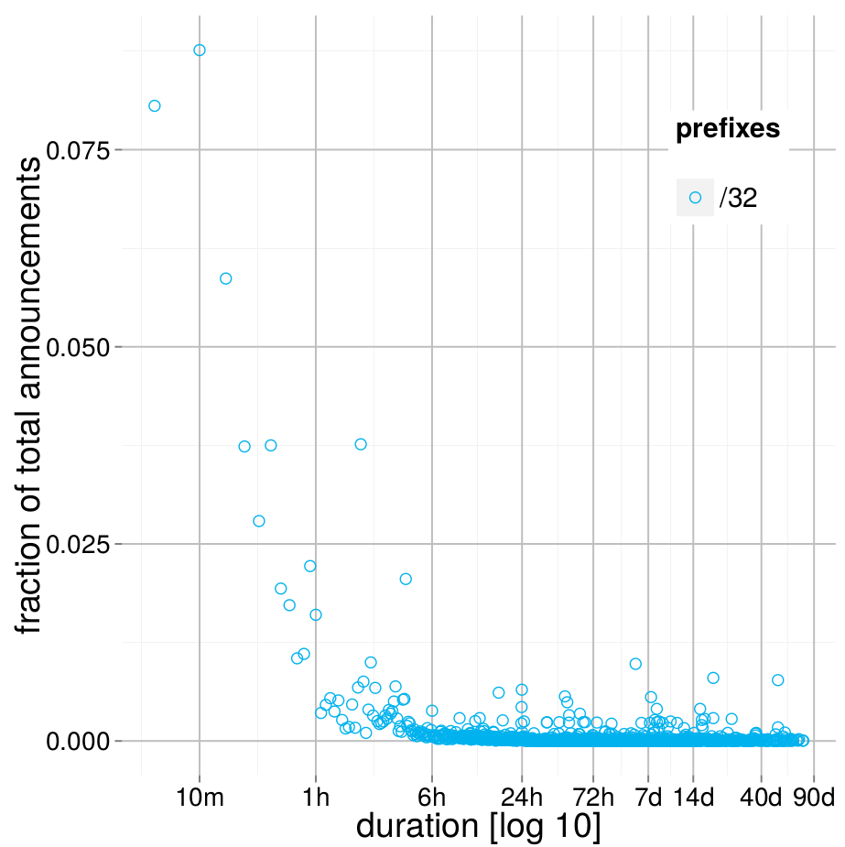
Blackholing Usage Analysis – Active Duration
Active duration per prefix (/32)
Majority is short-lived
(~50% <= 3 hours)
Longest observed announcement 76.31 days

Slide 11
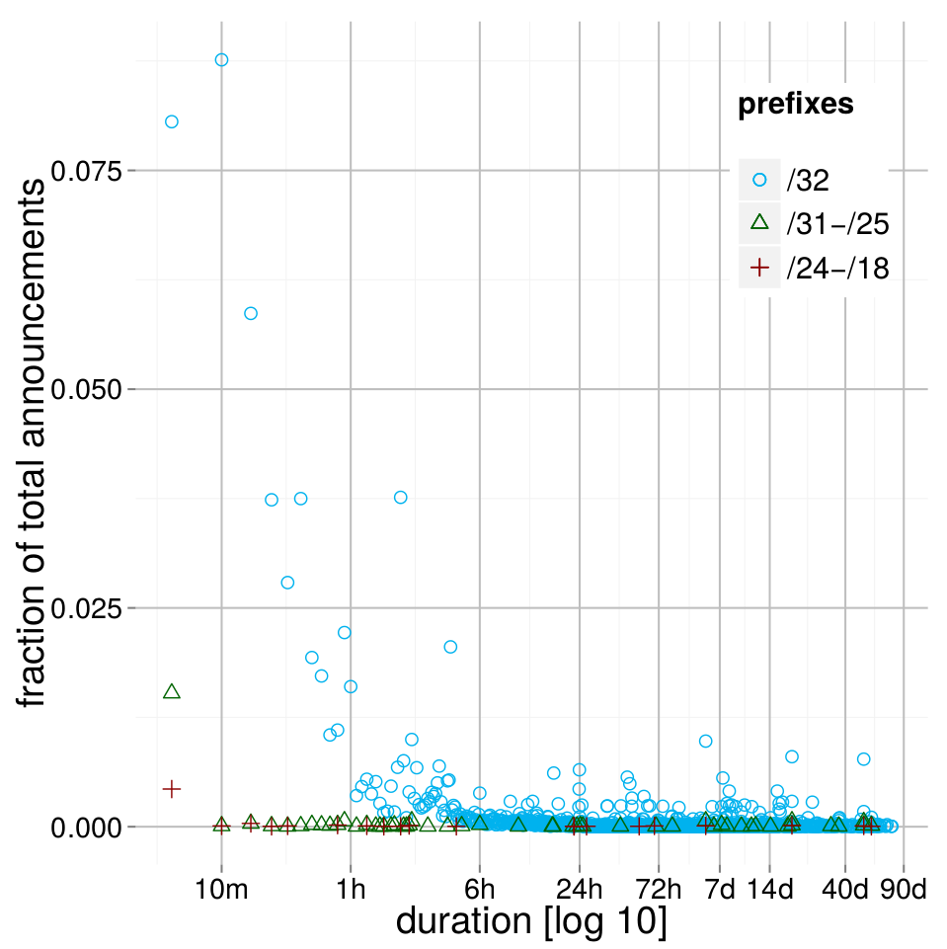
Blackholing Usage Analysis – Active Duration
Majority is short-lived
Also very long living announcements
Could be the same prefix?!

Slide 12
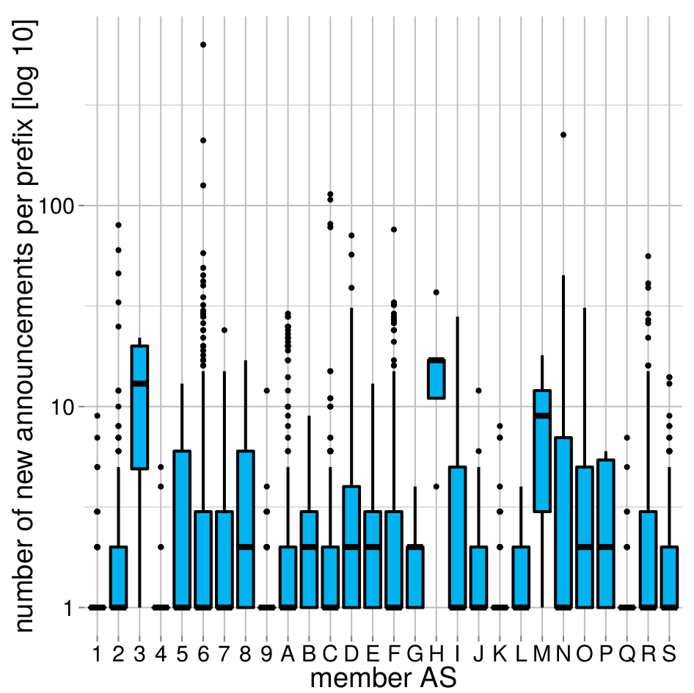
Blackholing Usage Analysis – Re-Announcements per Prefix
7,864 unique prefixes
Most prefixes announced once (10%), or between two and three times (15%)
Outliers spread from 10 to 100, max 623
Notes:
7, 864 unique prefixes
10% once, 15% between two and three times.

Slide 13
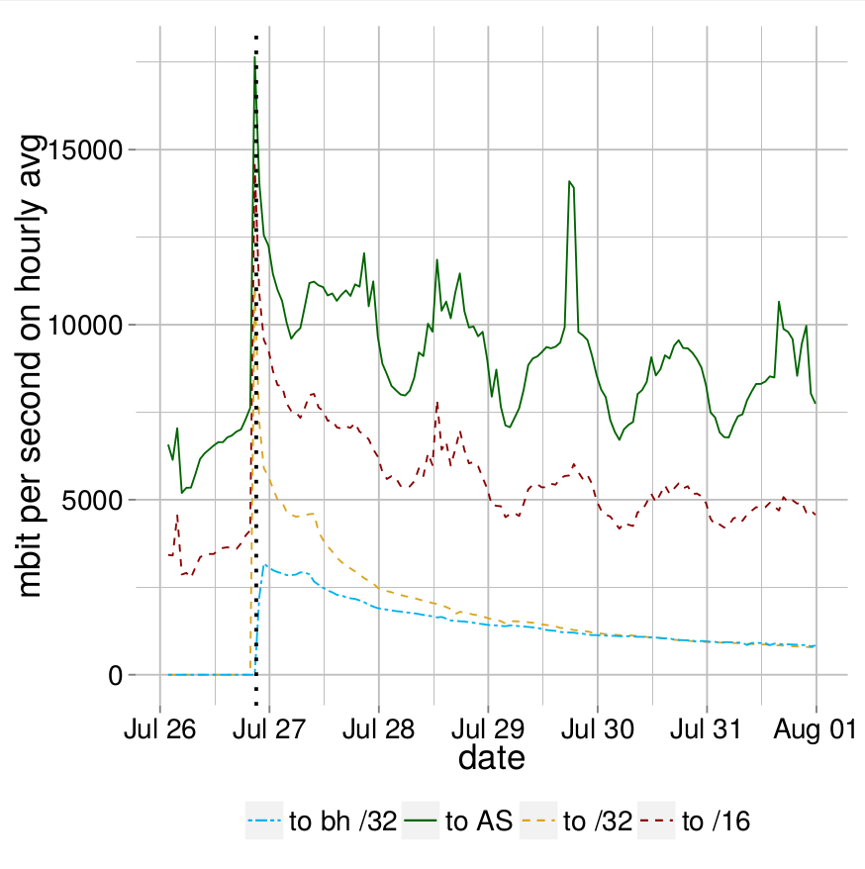
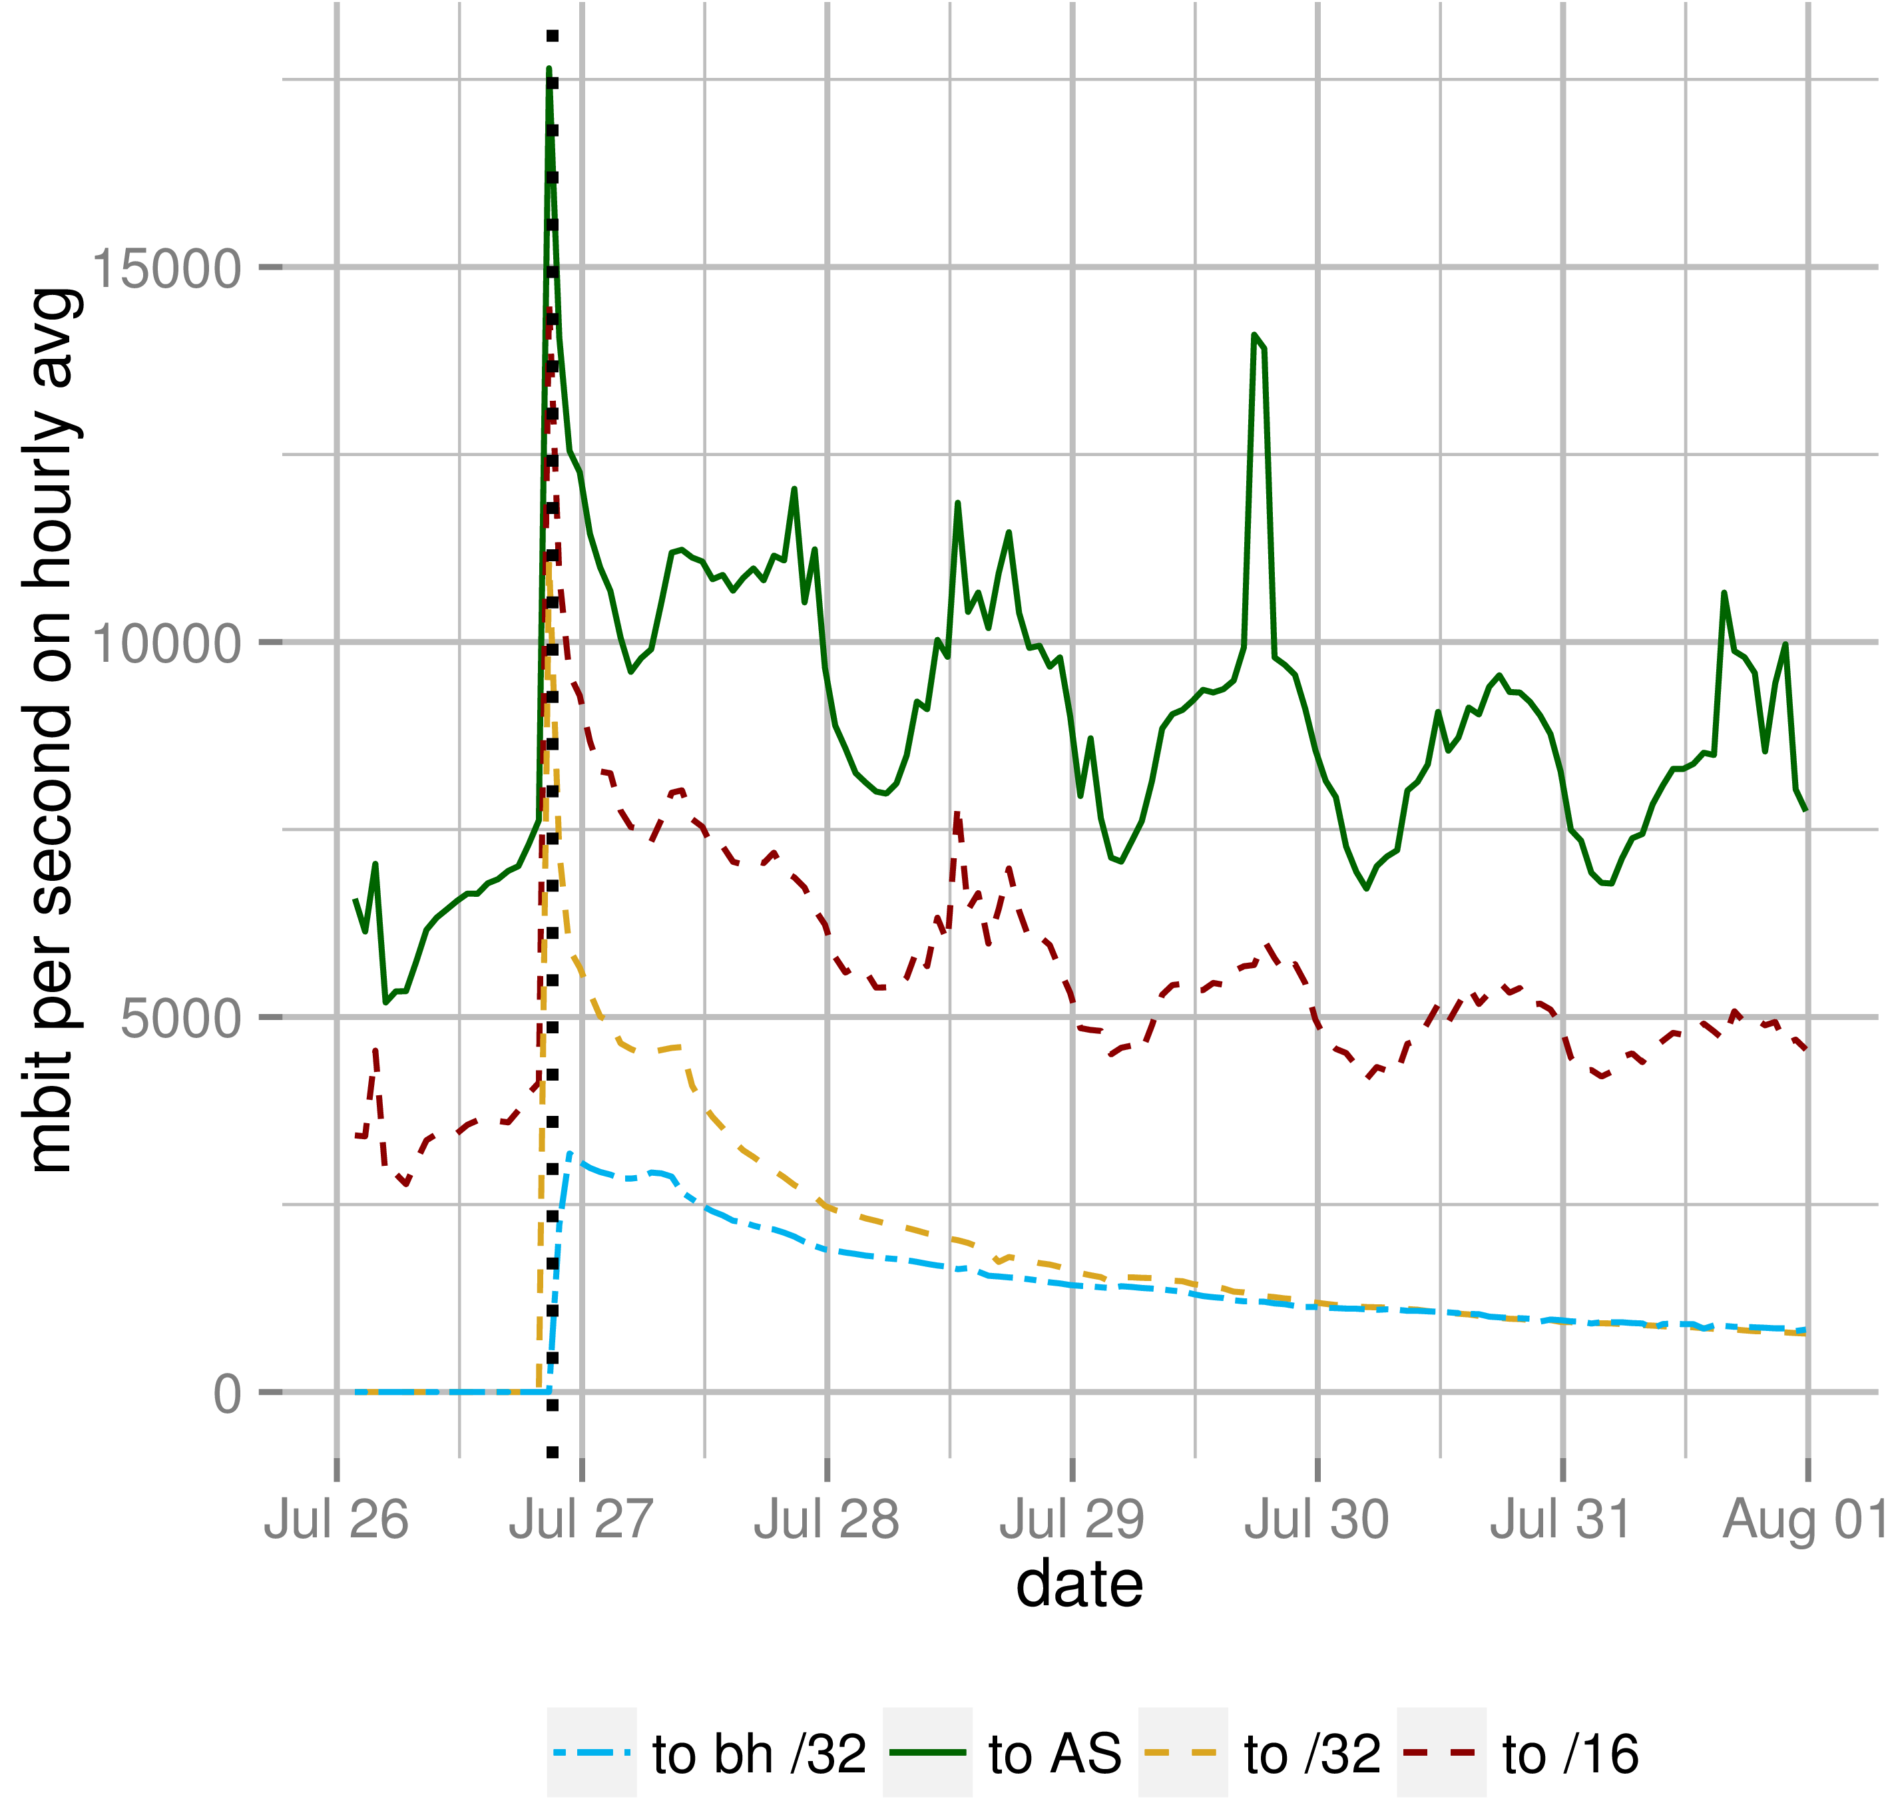
Case Study - Impact on Traffic
Traffic for one /32
Traffic rises up to 17.6 Gbit/s
Traffic is reduced by one third

Slide 14
Summary
23,000 announced blackholes (over a three month period)
Stable number of 1200 active blackholes
Observed least specific was a /18
Very diverse announcement patterns (frequency, duration, …)
Succeeds in mitigating large DDoS attacks
Full paper at http://www.net.t-labs.tu-berlin.de/papers/DFK-BIXPO-16.pdf

Slide 15



Comments? Questions?

